Slide 1


TACTICAL COMBAT CASUALTY CARE COURSE
Module 5: Tactical Trauma Assessment
MODULE 5: TACTICAL TRAUMA ASSESSMENT
TCCC TIER 1
All Service Members
TCCC TIER 2
Combat Lifesaver
TCCC TIER 3
Combat Medic/Corpsman
TCCC TIER 4
Combat Paramedic/Provider

Slide 2




Module 5: Tactical Trauma Assessment
TACTICAL COMBAT CASUALTY CARE ROLE-BASED TRAINING SPECTRUM
ROLE 1 CARE
NONMEDICAL PERSONNEL
MEDICAL PERSONNEL
YOU ARE HERE
STANDARDIZED JOINT CURRICULUM
2

Slide 3











Module 5: Tactical Trauma Assessment
1 x TERMINAL LEARNING OBJECTIVES
Given a combat or noncombat scenario, perform a Tactical Trauma Assessment
in accordance with Committee on Tactical Combat Casualty Care (CoTCCC) Guidelines.
06
  Identify the common causes of altered mental status in combat or noncombat environments. (CLS T6:E30)
  Demonstrate the techniques used to assess a casualty for responsiveness. (ASM T3:E9)
  Identify the importance of disarming and securing the communications equipment of a casualty whose mental status is altered. (CLS T6:E31)
  Identify the importance and techniques of communicating with a casualty in Tactical Field Care. (CLS T6:E32)
  Demonstrate communicating with a casualty in Tactical Field Care. (CLS T6:E33)
  Demonstrate applying body substance isolation in Tactical Field Care. (CLS T6:E34)
  Demonstrate a Tactical Trauma Assessment in the proper order using the MARCH PAWS sequence in accordance with CoTCCC Guidelines.
  Demonstrate the appropriate actions and interventions used in a casualty assessment to render aid to the casualty in accordance with CoTCCC Guidelines.
8 x ENABLING LEARNING OBJECTIVES
= Terminal Learning Objectives = Cognitive ELOs = Performance ELOs
#
3

Slide 4

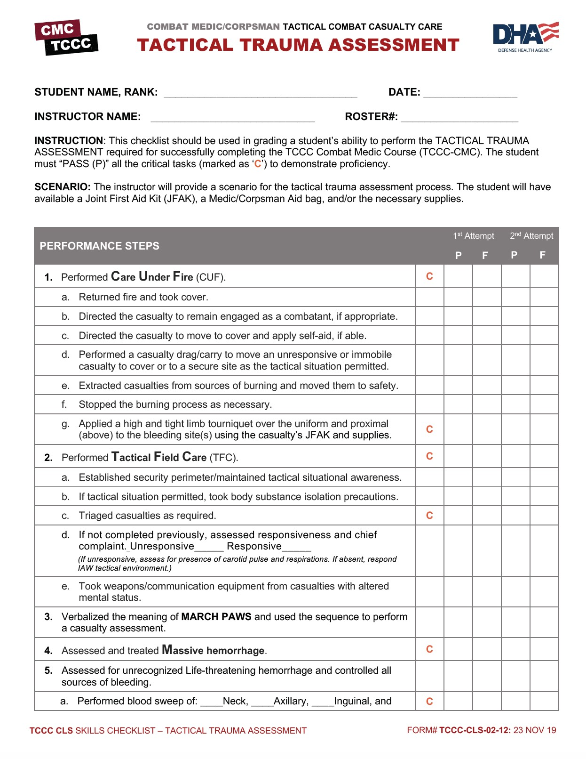
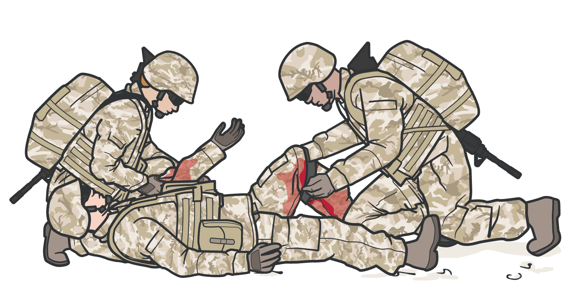
INTRODUCTION TO TACTICAL TRAUMA ASSESSMENT (TTA)
Standardized Approach to Assessing a Combat Casualty
Module 5: Tactical Trauma Assessment
RELIABLE, PROVEN METHODOLOGY
Allows seamless approach for multiple responders

Slide 5
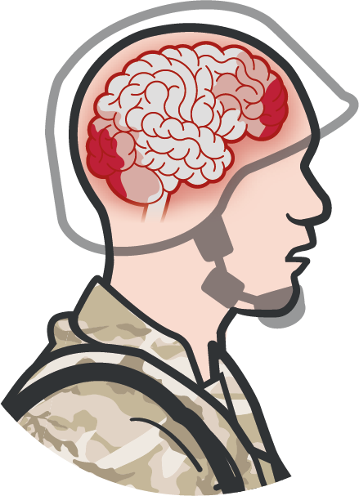
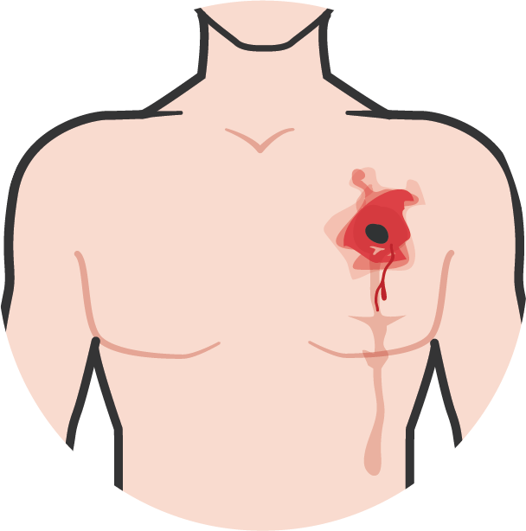
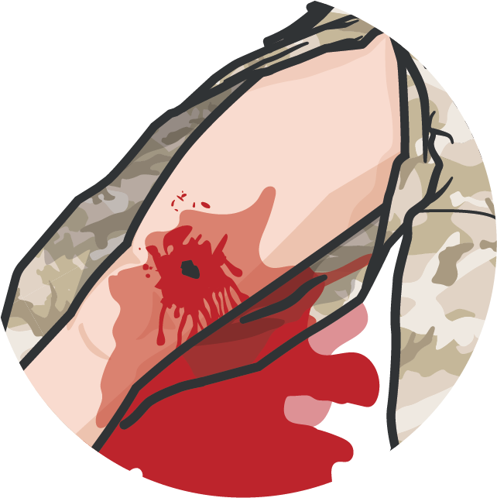

CAUSES OF ALTERED MENTAL STATUS
Module 5: Tactical Trauma Assessment
TRAUMATIC BRAIN INJURY
HYPOXEMIA
HYPOVOLEMIA/SHOCK
HYPOTHERMIA also contributes to altered mental status

Slide 6
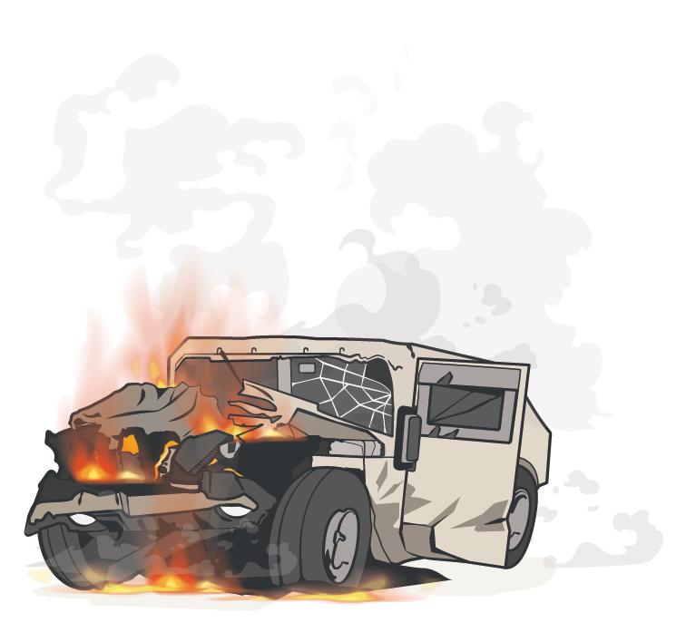
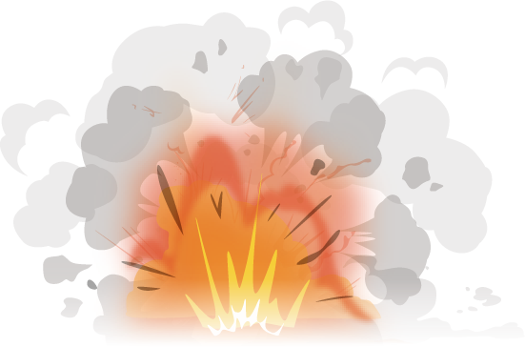
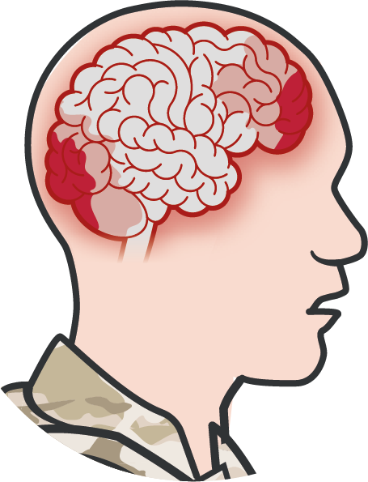
TECHNIQUES TO ASSESS RESPONSIVENESS ALTERED MENTAL STATUS
Module 5: Tactical Trauma Assessment
ASSESS THE MECHANISM OF INJURY
COMMUNICATE WITH THE CASUALTY
A
V
lert
erbal Stimuli
P U
ainful Stimuli
Blasts
MVAs
Direct Blow to the Head
nresponsive

Slide 7
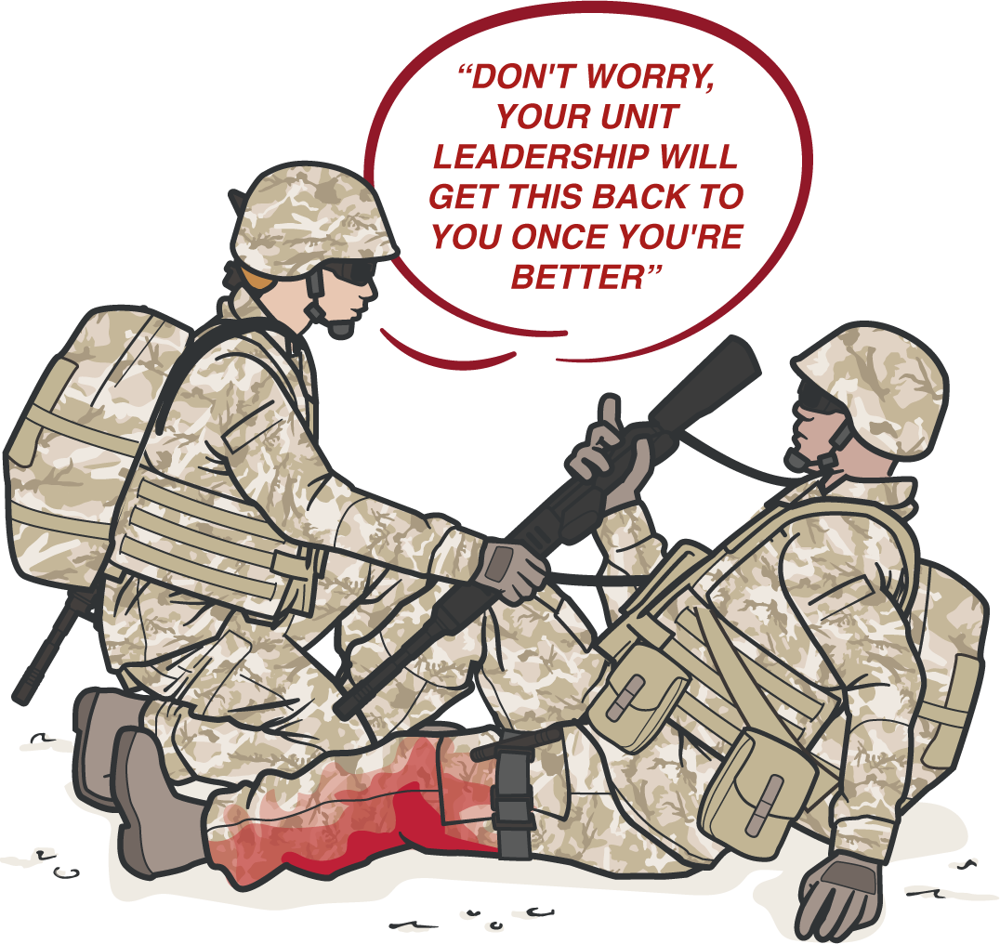


DISARMING CASUALTIES
AND SECURING COMM EQUIPMENT
Module 5: Tactical Trauma Assessment
REMOVE CASUALTY’S
WEAPON, unit leadership (or delegated personnel) should take responsibility for it
This includes COMMUNICATION EQUIPMENT or CLASSIFIED MATERIAL(s)

Slide 8
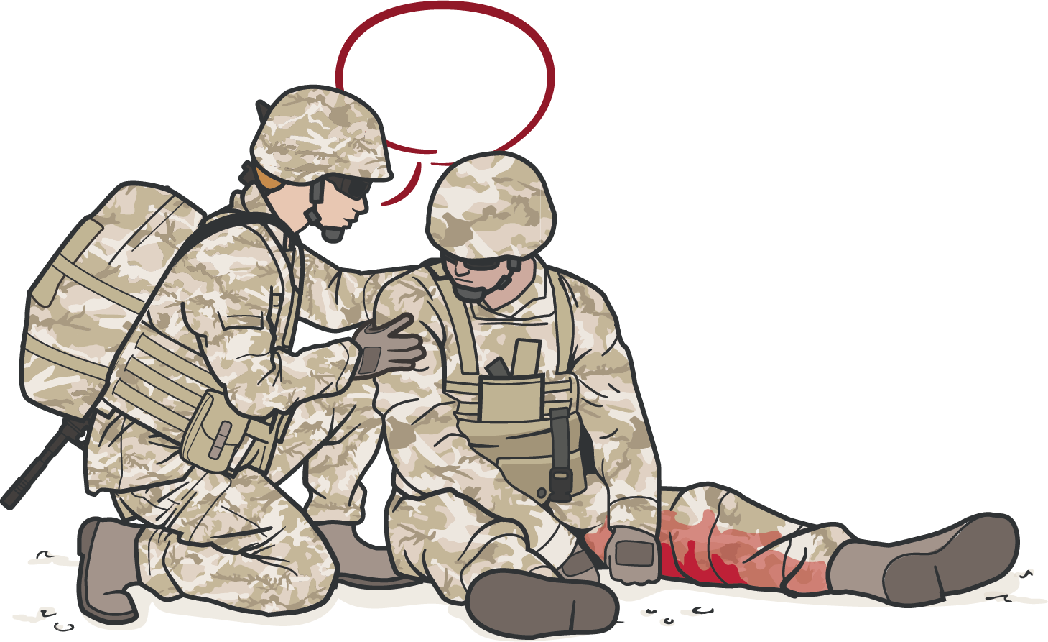
COMMUNICATE WITH CASUALTIES
Module 5: Tactical Trauma Assessment
Communicating may improve the casualty outcome – better able to explain symptoms and follow commands; less stress
COMMUNICATE with the casualty if possible
Encourage
Reassure
Explain care each step of the way
Communicate throughout TTA to determine if the casualty's mental status begins to change – a potential sign that something is wrong and they need to be reassessed

Slide 9
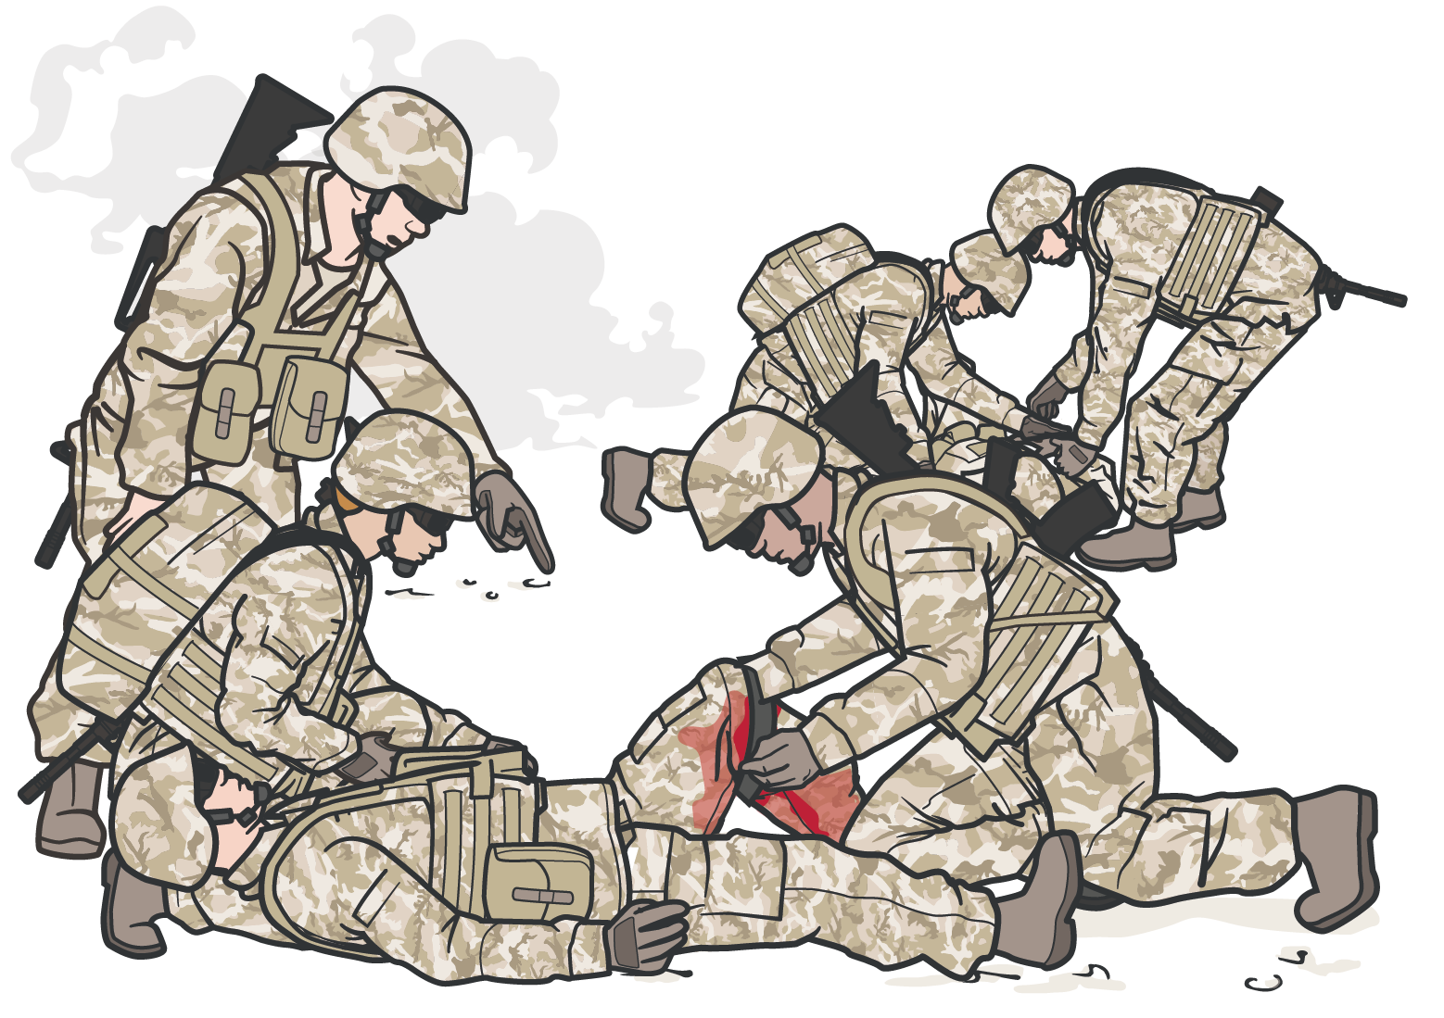
TRIAGE AND DIRECT OTHER RESPONDERS
Module 5: Tactical Trauma Assessment
If MULTIPLE CASUALTIES
are present, you may need to TRIAGE before starting an individual casualty TTA
DIRECT COMBAT
LIFESAVERS or other responders to help – you cannot do everything yourself

Slide 10
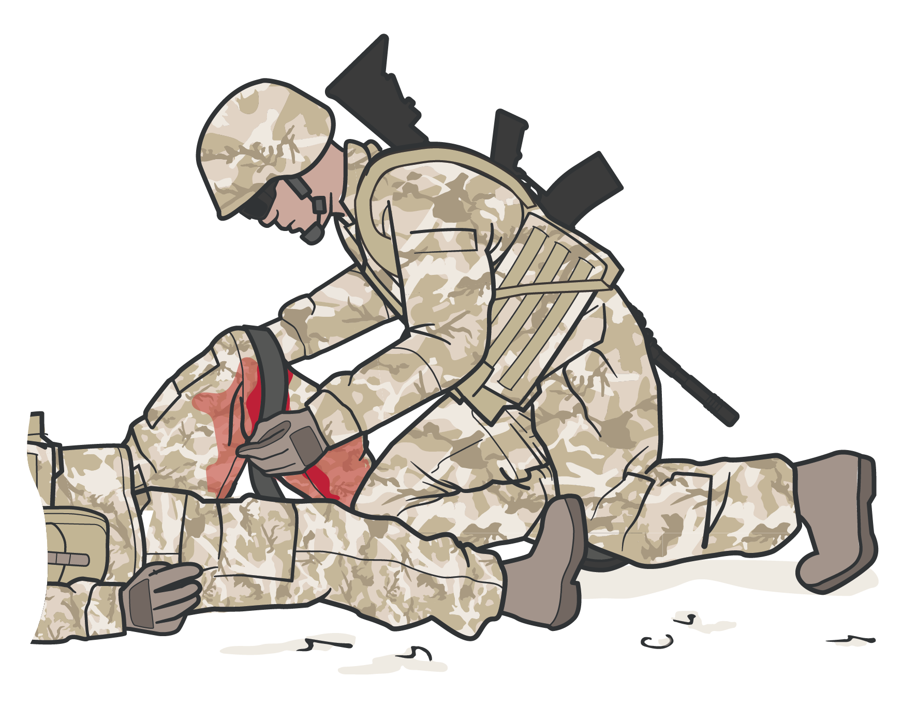


BODY SUBSTANCE ISOLATION (BSI)
Module 5: Tactical Trauma Assessment
As a precaution, the responder should don latex-free gloves whenever possible
In CARE UNDER FIRE or other tactical situations, BSI may not be feasible

Slide 11


TTA SEQUENCE
Module 5: Tactical Trauma Assessment (in depth)
DURING LIFE-THREATENING AFTER MARCH
AFTER PAWS
M A R C H
MASSIVE BLEEDING
REASSESS MARCH
PAIN
REASSESS MARCH PAWS
CUF or TFC
AIRWAY
#1 Priority
P A W S
PREPARATION FOR EVACUATION
RESPIRATION (breathing)
ANTIBIOTICS
CIRCULATION
WOUNDS
CONSIDER DETAILED EXAMINATION
HYPOTHERMIA / HEAD INJURIES
SPLINTING
COMMUNICATION AND DOCUMENTATION

Slide 12
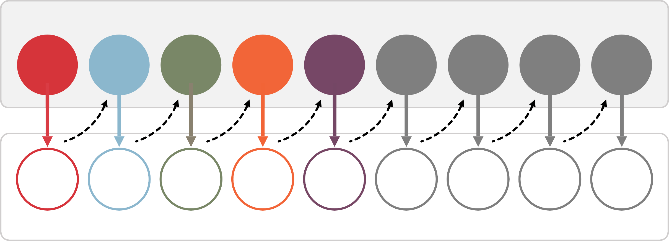
TACTICAL TRAUMA ASSESSMENT PROCESS
Module 5: Tactical Trauma Assessment
Assessment
M | A | R | C | H | P | A | W | S
M | A | R | C | H | P | A | W | S
Intervention(s)

Slide 13
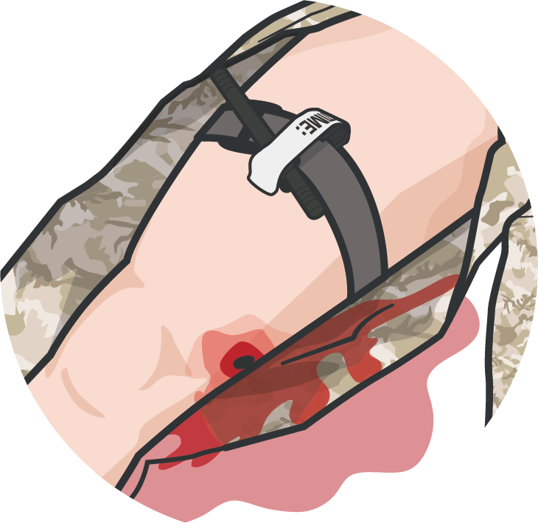
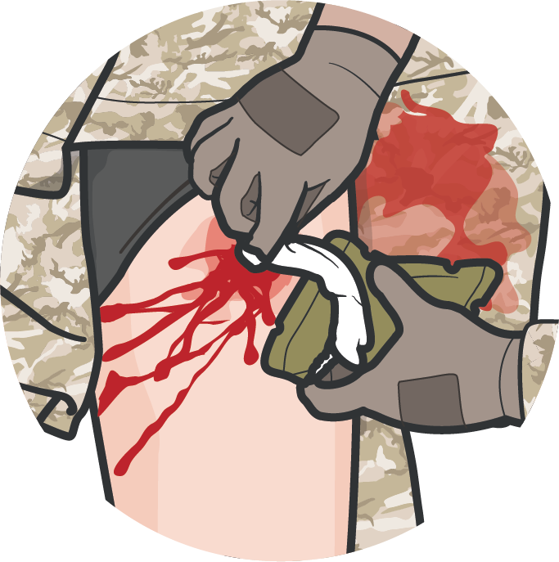
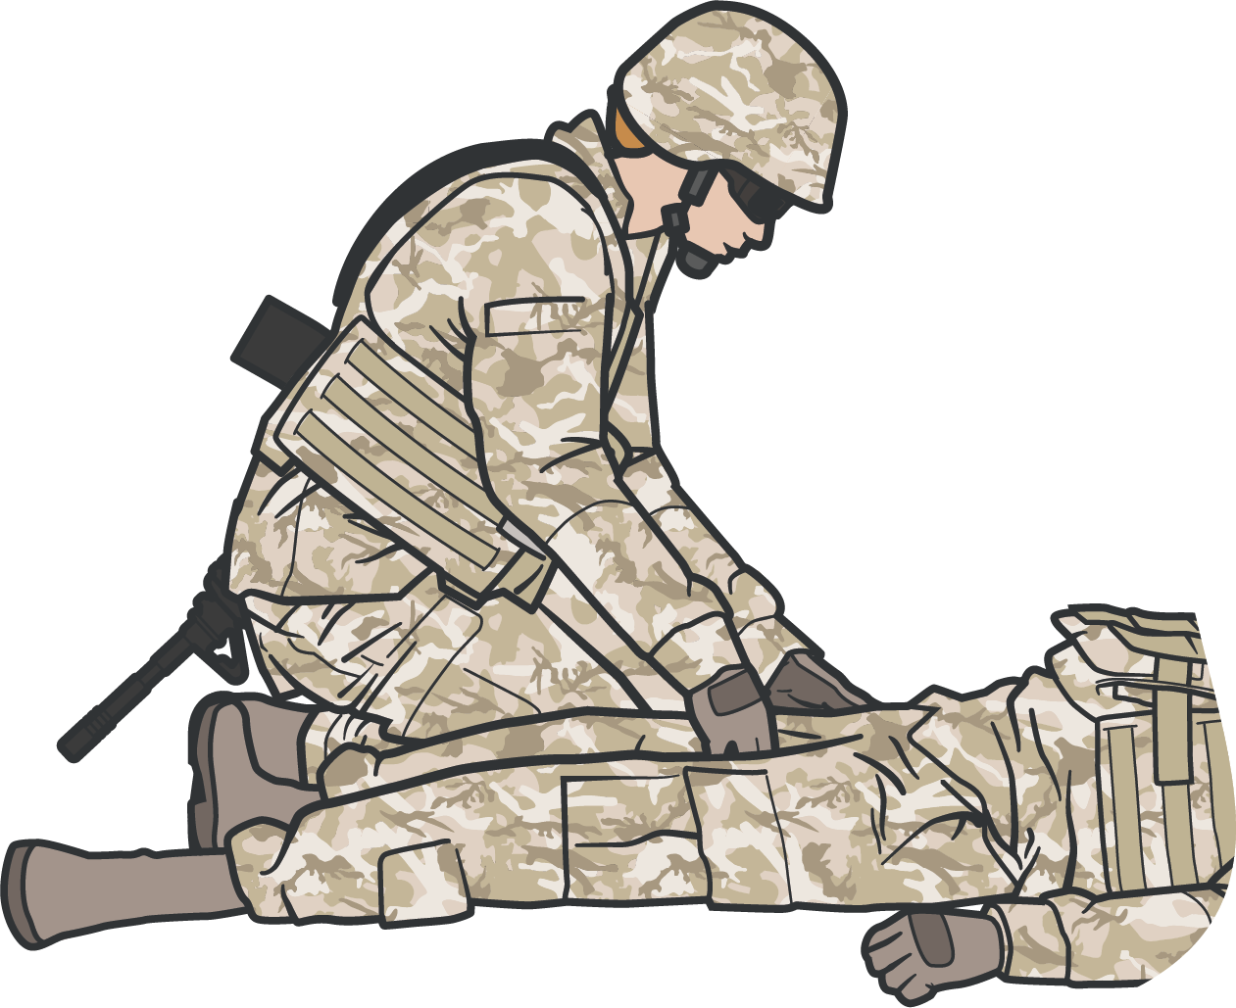
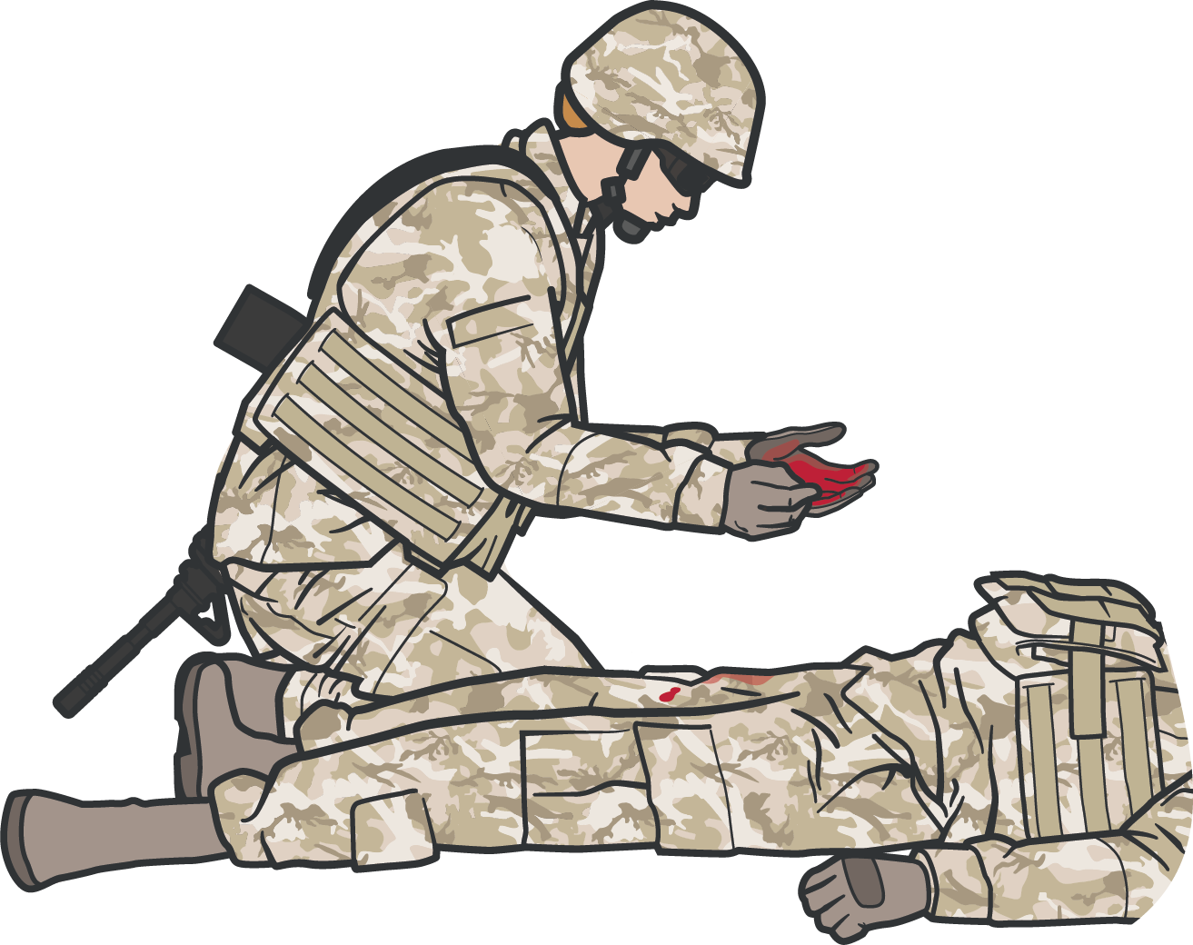
BEGIN WITH HEMORRHAGE CONTROL AND BLOOD SWEEP
Module 5: Tactical Trauma Assessment
After treating obvious massive hemorrhage, do a rapid head-to-toe check for any unrecognized life- threatening bleeding
M
Treat any obvious massive hemorrhage with limb tourniquets, wound packing, pressure bandages, or junctional tourniquets, as appropriate
Check the neck, axillary, and inguinal areas Check the arms, legs, abdomen, chest,
and back

Slide 14
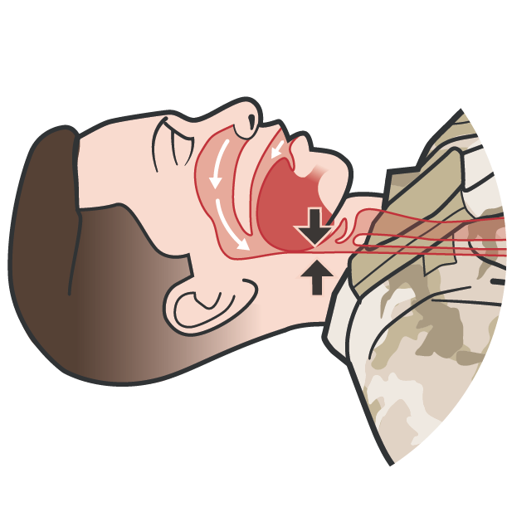
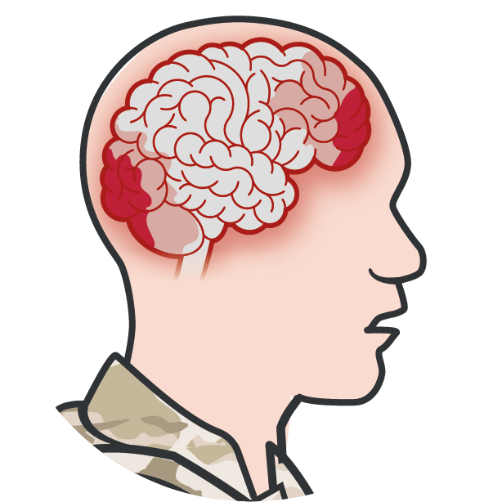
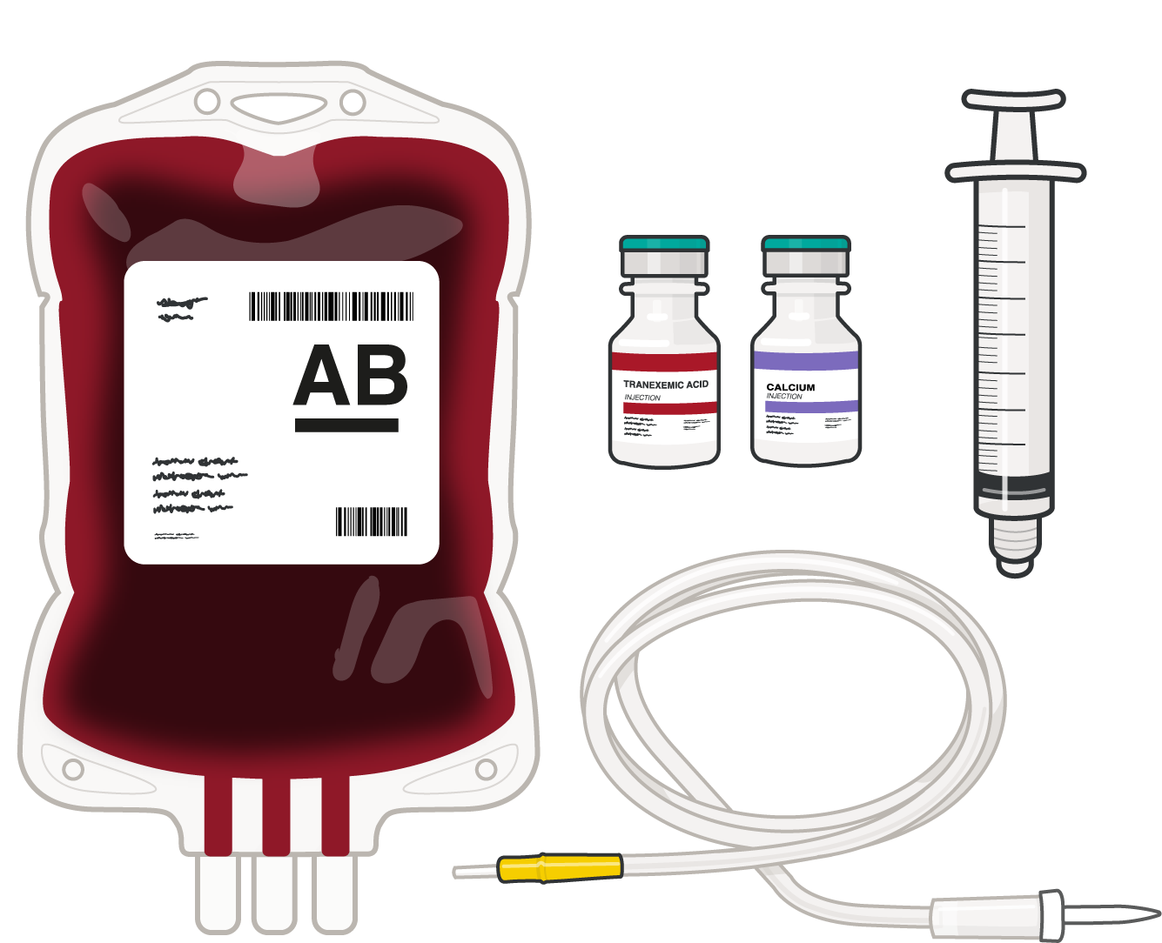
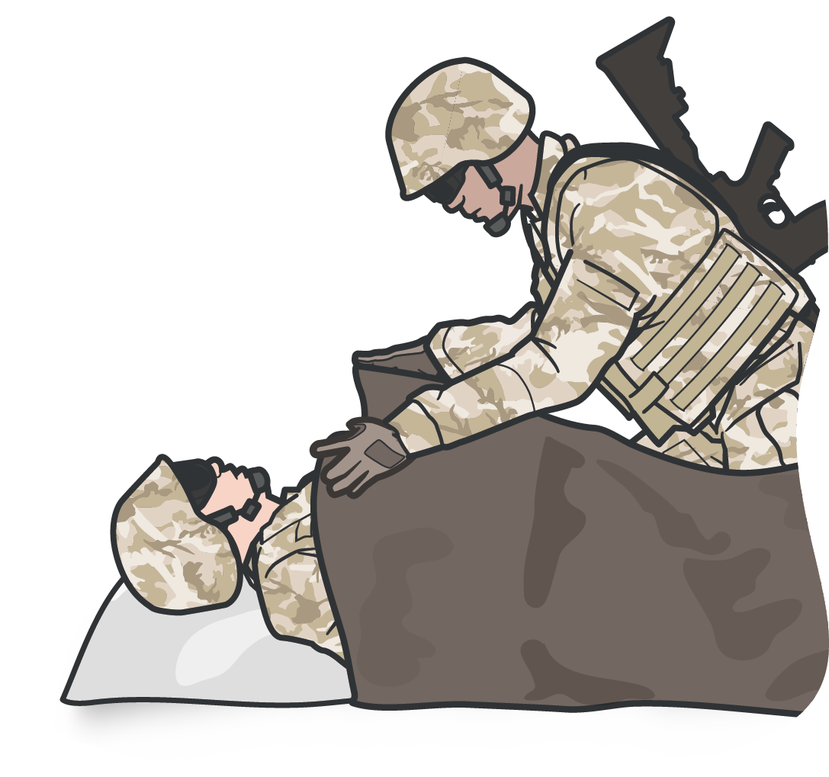
CONTINUE TTA WITH REST OF MARCH SEQUENCE
Module 5: Tactical Trauma Assessment
A
Relieve any airway obstructions or pending airway obstructions with maneuvers, airway adjuncts, or establish a new airway surgically
R
Treat open chest wounds with vented chest seals and tension pneumothorax with needle decompression of the chest
C
Establish intravenous or intraosseous access, administer TXA, and treat hemorrhagic shock with blood products
H
Use active and passive measures to prevent or treat hypothermia
Assess and document all head and penetrating eye injuries

Slide 15
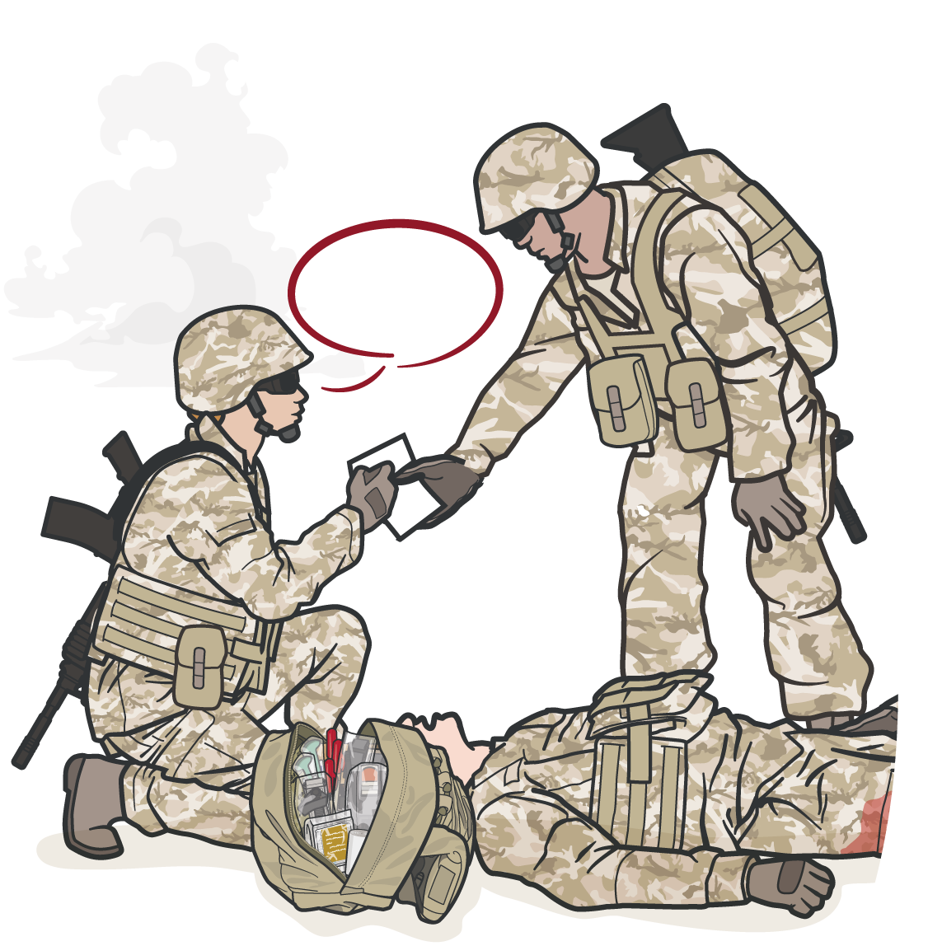
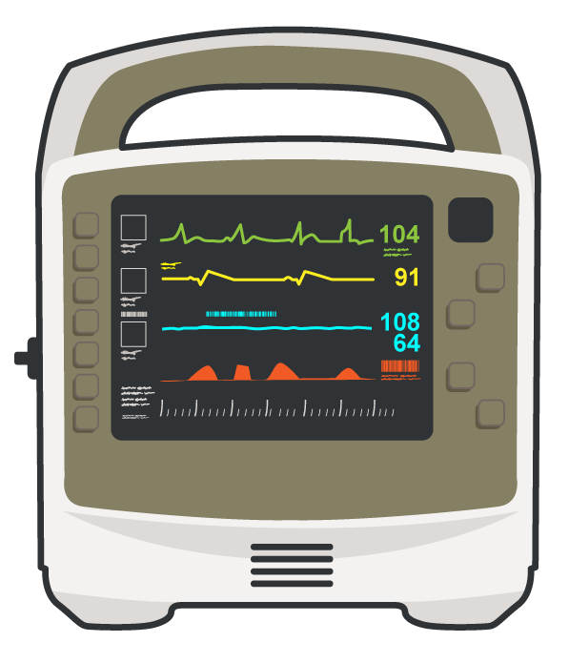
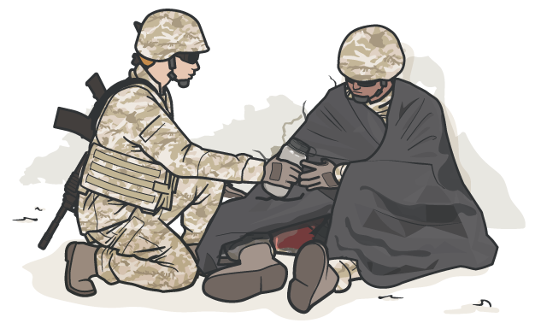
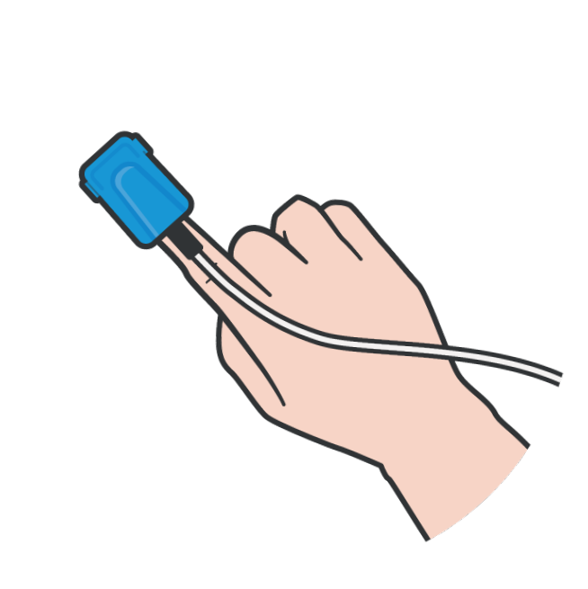
Module 5: Tactical Trauma Assessment
INITIATE MEDICAL EVACUATION
PREPARE EVAC REQUEST
MONITOR THE CASUALTY
Relay required MEDEVAC request information to the tactical leader in accordance with unit standard operating procedures
REASSESS all lifesaving interventions (MARCH sequence) and continue with the PAWS portion if time permits
INITIATE ELECTRONIC
MONITORING if indicated and equipment is available

Slide 16

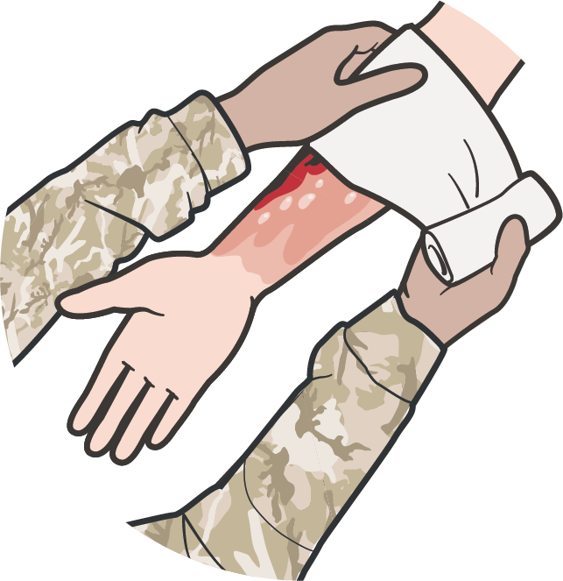

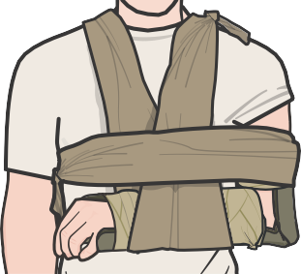
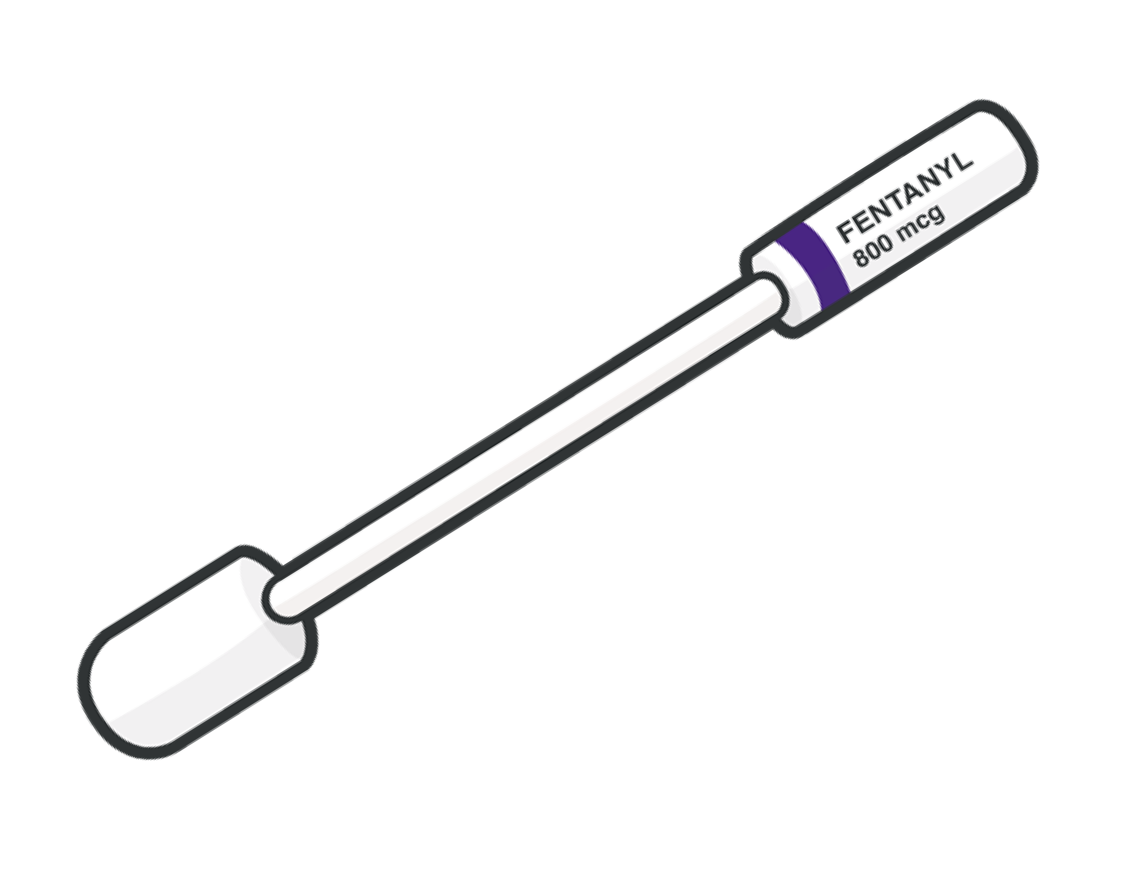
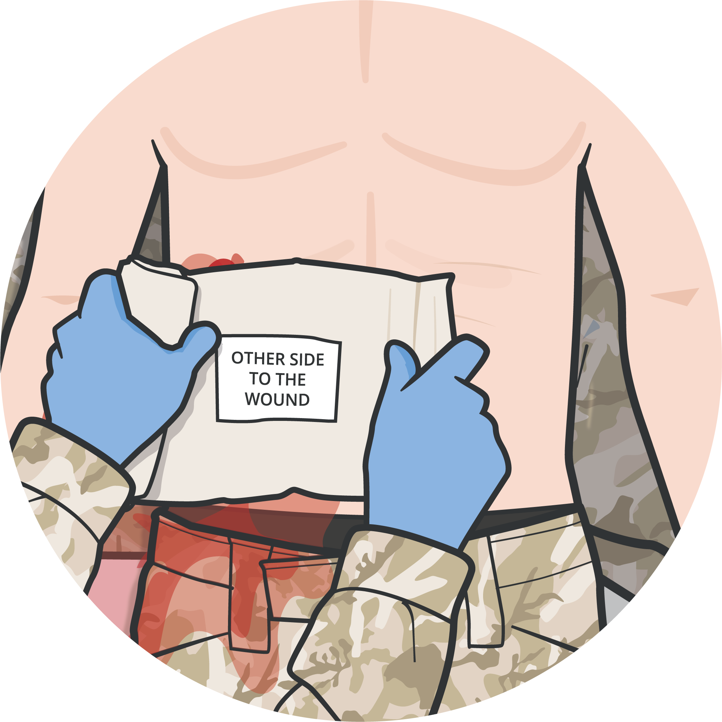
COMPLETE THE TTA BY ADDRESSING PAWS
Module 5: Tactical Trauma Assessment
P
Assess for pain and administer the appropriate pain control medications
A
Administer Antibiotics for all open combat wounds
W
Address additional wounds (abdominal injuries, burns, minor lacerations, etc.) as soon as possible
S
Splint and secure
fractures before evacuation (if time permits)

Slide 17
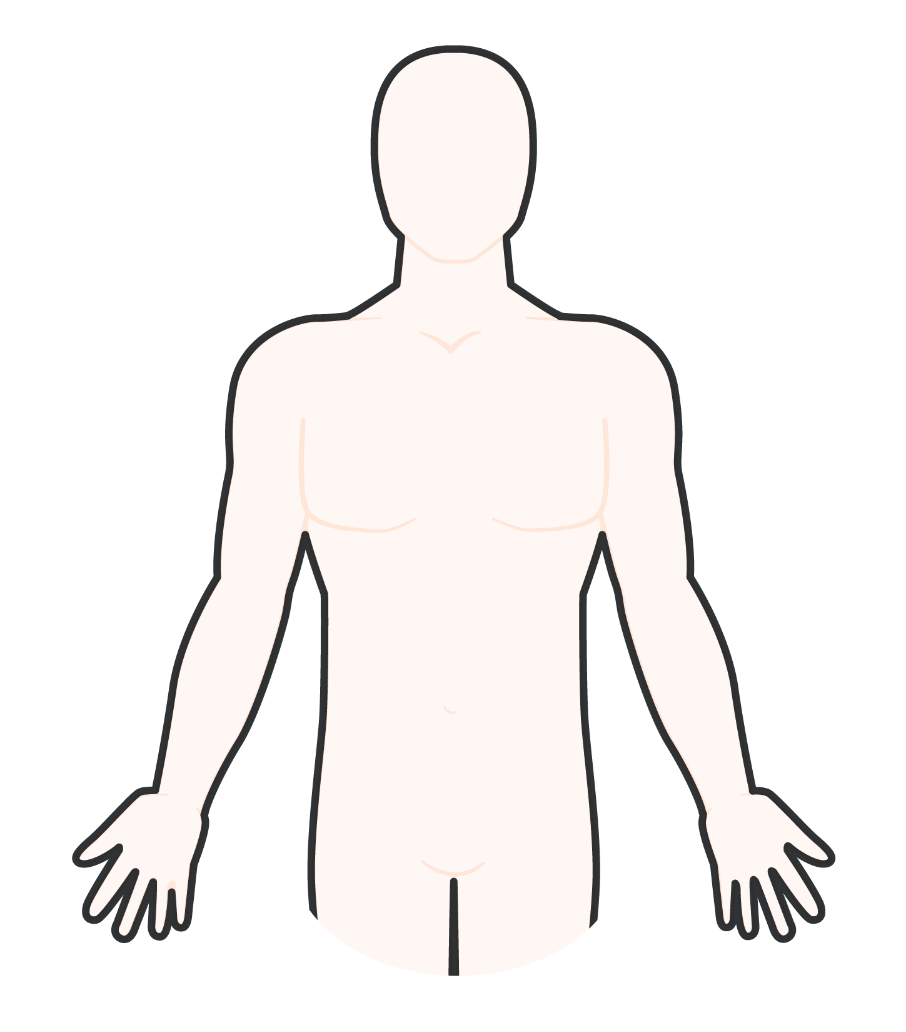



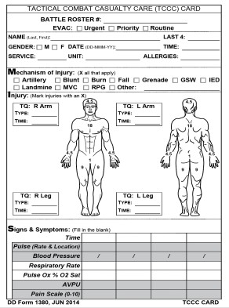
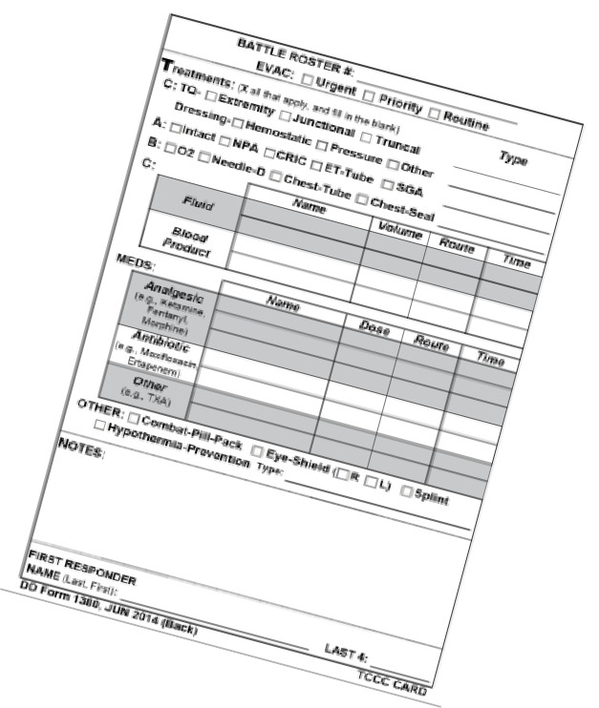
SECONDARY ASSESSMENT/DETAILED EXAM
Module 5: Tactical Trauma Assessment
Start at the head and work your way to the toes
Treat minor injuries as
1
2
Head Neck
7
Thorax, Lumbar, and Buttocks
Upper Extremities
they are found
Document any findings on the DD Form 1380
3
Chest
6
4
Abdomen/ Pelvis, Groin, Perineum
5
Lower Extremities
The detailed examination takes some time, and may not be an option if evacuation is ready or multiple casualties require attention

Slide 18
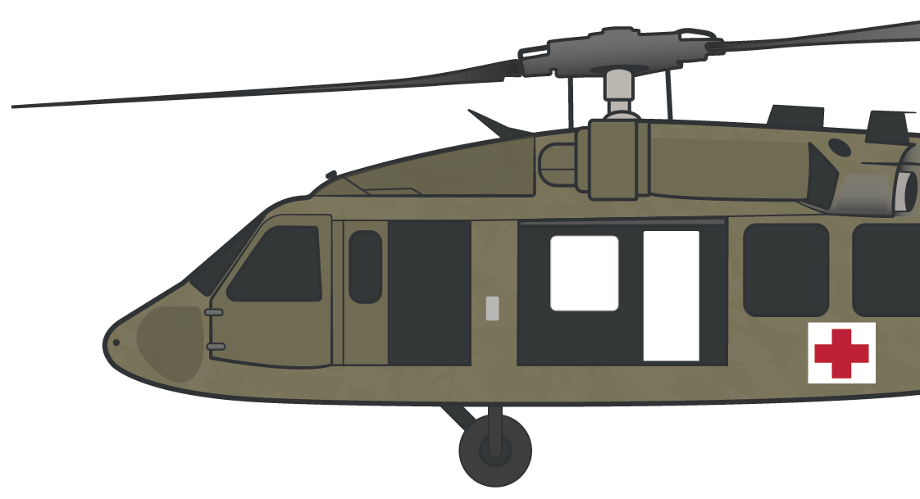
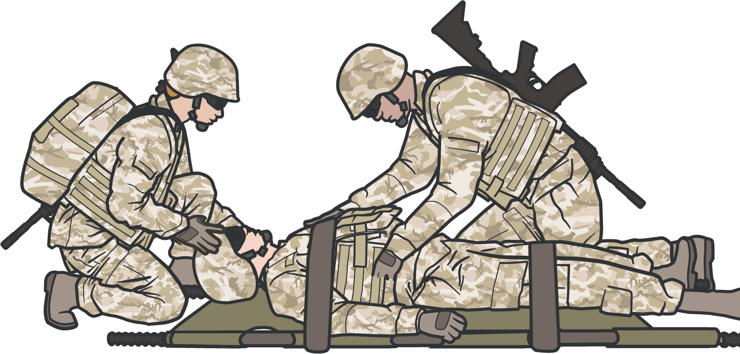


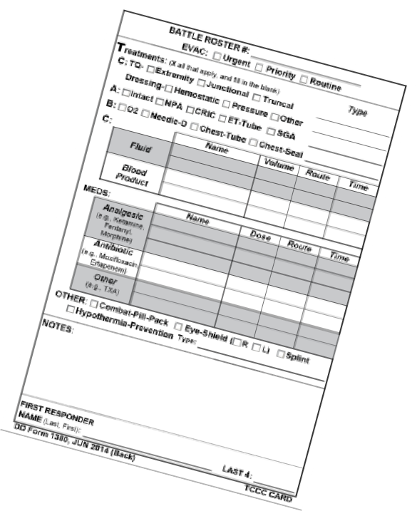
Module 5: Tactical Trauma Assessment
PREPARE FOR EVACUATION
PREP CASUALTY
PREP SITE AND EVAC SUPPORT
Prep evac equipment Prep litter
Pack casualty Secure loose items
(bandages, blankets, etc.)
Establish security
Instruct ambulatory casualties
Stage casualties
Monitor the Casualty
Continue to REASSESS / REASSURE and monitor the casualty during evacuation preparation phase
Ensure Completion MIST report
_{M} Mechanism of injury
I S T
Injuries Symptoms Treatment
Complete DD Form 1380
PREPARE EVAC REQUEST
Use MEDEVAC format

Slide 19
SUMMARY
Module 5: Tactical Trauma Assessment
Defining Tactical Trauma Assessment
Determining common causes of and techniques to assess altered mental status
Disarming and removing communication equipment when mental status is altered
Communicating with the casualty throughout the TTA Considering body substance isolation
Following the MARCH PAWS sequence when performing a TTA

Slide 20

CHECK ON LEARNING
Module 5: Tactical Trauma Assessment (in depth)
During which phase of care is most of the Tactical Trauma Assessment performed?
What pneumonic is used to prioritize care during the Tactical Trauma Assessment?
Why is it important to assess the casualty’s mental status?
What is a blood sweep?

Slide 21



Module 5: Tactical Trauma Assessment (in depth)
ANY QUESTIONS?

Slide 22

Module 5: Tactical Trauma Assessment (in depth)
TRAINER-LED DEMONSTRATION
TACTICAL TRAUMA ASSESSMENT

Slide 23

REFERENCES
Module 5: Tactical Trauma Assessment
TCCC: Guidelines
by JTS/CoTCCC
Updated regularly – latest edition dated 5 November 2020
These guidelines are the result of decisions made by the Committee on Tactical Combat Casualty Care as they explore evidence-based research regarding best practices
PHTLS: Military Edition
by NAEMT
Prehospital Trauma Life Support,
Military Ninth Edition, teaches and reinforces the principles of rapidly assessing a trauma patient using an orderly approach
NOV 2020

